Slide 1

Bank Note Authentication
By,
Shraddha Dalal
Batch
PGA 33

Slide 2





Shraddha Dalal
Aspiring Data Scientist
Education
Skills
Contact
Post Graduate in Data Analytics and Machine Learning Imarticus Learning, Pune | Present
Master Of Computer Application
Jain University , Bangalore | June 2022
Bachelor Of Computer Application
Dr.Ambedkar College, Nagpur | Oct 2020
SQL
HTML
Pune, Maharashtra
Time Series
9922337151
Machine
Learning
Python
Data Visualization
shraddhadalal15@gmail.com
Deep Learning
Microsoft Office
linkedin.com/in/shraddha15dalal
Projects
shraddhadalal15@gmail.com
Classification Analysis
Dataset : Banknote Authentication
Languages
The main purpose of the project is to predict whether a given banknote is authentic or forged given a number of measures taken from a photograph.
Hobbies
English
Regression Analysis
Dataset : Melbourne Housing
Handeled missing values
Visualized the data with the help of Matplotlib and Seaborn
Linear and Multiple Regression analysis was done
Hindi
Baking
Music
Travelling
Reading Books
Marathi
Software Piracy Protection
Developed this project to maintain software copyright protection and assures that it is being accessed only by the authenticated users.

Slide 3
Agenda
Resume
Problem statement
Introduction
Attribute information
Visualization
Model
Report
Result
Conclusion

Slide 4

Problem Statement
The main objective is to predict whether the Bank note is genuine or forged

Slide 5
Introduction
Despite use of electronic transactions, cash transactions remain very important in the global market
To continue with smooth cash transactions, entry of forged banknotes in circulation should be preserved
There has been a drastic increase in the rate of fake notes in the market
It is difficult for human-eye to recognize a fake note because they are created with great accuracy to look alike a genuine note

Slide 6
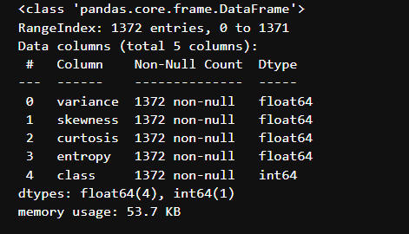
Attribute Information
Attribute Name | Value Type | Description
Variance | Continuous | Variance finds how each pixel varies from the neighboring pixels
Skewness | Continuous | Skewness is the measure of the lack of symmetry
Kurtosis | Continuous | Kurtosis is a measure of whether the data are heavy-tailed or light-tailed relative to a normal distribution
Entropy | Continuous | Image entropy is a quantity which is used to describe the amount of information which must be coded for, by a compression algorithm
Class | Integer | Class contains two values 0 representing genuine note and 1 representing fake note

Slide 7
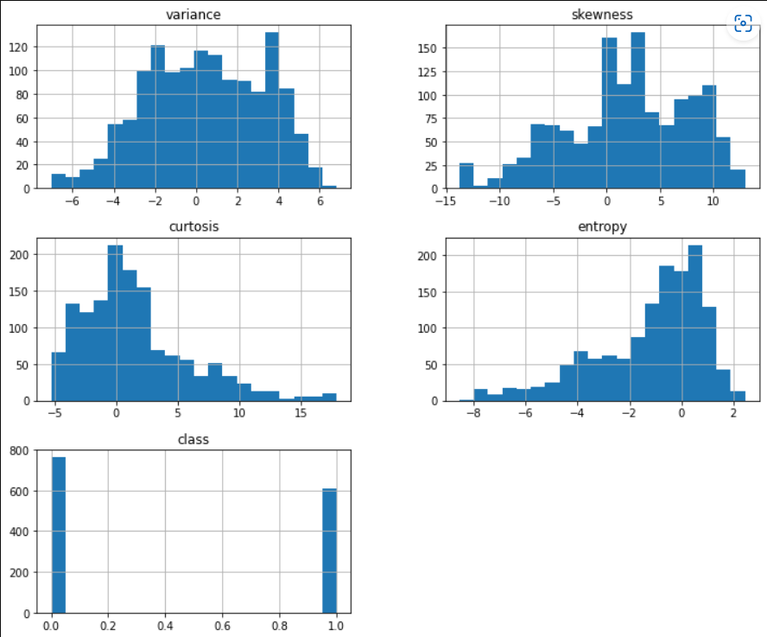
Exploratory Data Analysis
Univariate Analysis
The first two variables have a Gaussian-like distribution
Curtosis and Entropy have skewed distribution

Slide 8
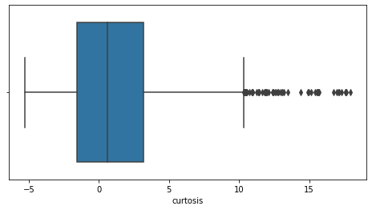
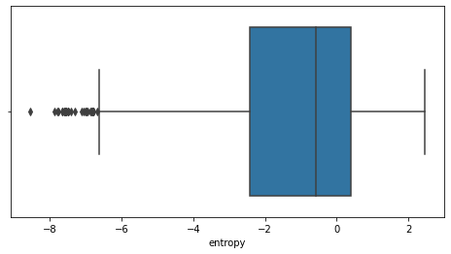
Box Plot
Curtosis
Entropy
Before Handling Outliers

Slide 9
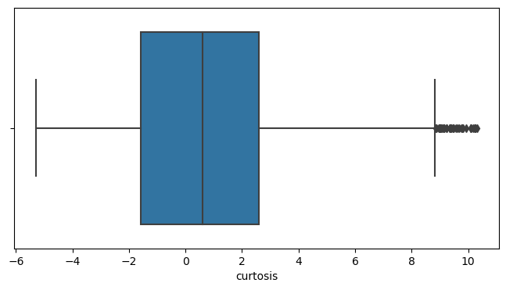
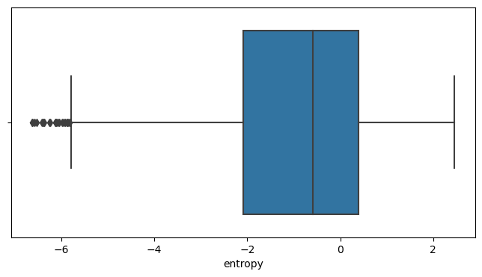
Curtosis
Entropy
After Handling Outliers

Slide 10
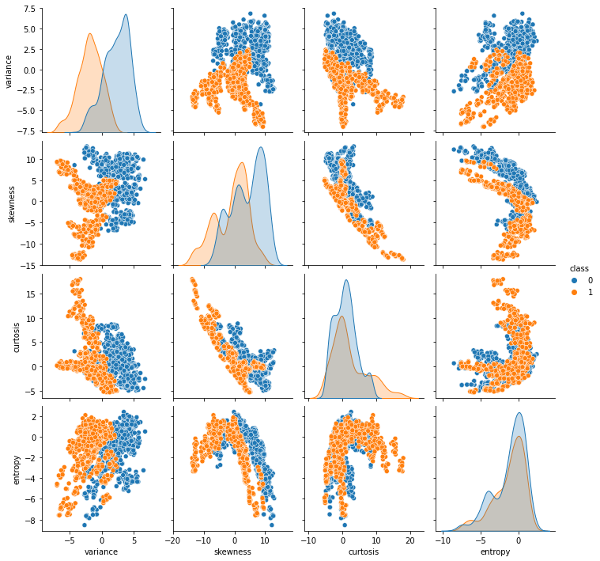
Bivariate Analysis
Entropy and Variance have a slight linear correlation
Similarly, there is an inverse linear correlation between the curtosis and skewness
Curtosis and Entropy are slightly higher for real banknotes
Skewness and Variance are higher for the fake banknotes

Slide 11
Models
Logistic Regression
Decision Tree Algorithm
Support Vector Machine
KNN
Random Forest
Naive Bayes
Bagging Classifier
Adaboost Classifier
Gradient Boosting Classifier

Slide 12
Train Test Split
Splitting the data into train set and test set
from sklearn.model_selection import train_test_split
X_train, X_test, y_train,y_test = train_test_split(X, y, test_size = 0.2, random_state = 42)

Slide 13
1) Logistic Regression
Logistic regression is a statistical analysis method to predict a binary outcome, such as yes or no, based on prior observations of a data set.
Performance
Train Result: 0.9973
Test Result: 0.9818
After cross validation
Training Accuracy: 99.64
Testing Accuracy: 98.90

Slide 14
2) Decision Tree Algorithm
A decision tree is a very specific type of probability tree that enables you to make a decision about some kind of process.
Performance
Train Result: 1.0000
Test Result: 0.9854
After cross validation
Training Accuracy: 98.27
Testing Accuracy: 96.02

Slide 15
3) Support Vector Machine
Performance
Train Result: 0.9991
Test Result: 0.9854
After cross validation
Training Accuracy: 99.82
Testing Accuracy: 97.40

Slide 16
4) K-Nearest Neighbor (KNN)
K Nearest Neighbour is a simple algorithm that stores all the available cases and classifies the new data or case based on a similarity measure.
Performance
Train Result: 0.9991
Test Result: 1.0
After cross validation
Training Accuracy: 99.91
Testing Accuracy: 98.54

Slide 17
5) Random Forest
Random Forest is a classifier that contains a number of decision trees on various subsets of the given dataset and takes the average to improve the predictive accuracy of that dataset.
Performance
Train Result: 1.0000
Test Result: 0.9927
After cross validation
Training Accuracy: 99
Testing Accuracy: 98.92

Slide 18
6) Naive Bayes
A Naive Bayes classifier is a probabilistic machine learning model that's used for classification task.
Performance
Train Result: 0.8715
Test Result: 0.8181
After cross validation
Training Accuracy: 86.23
Testing Accuracy: 84.38

Slide 19
7) Bagging Classifier
It creates a different training subset from sample training data with replacement & the final output is based on majority voting.
Performance
Train Result: 1.0000
Test Result: 0.9927
After cross validation
Training Accuracy: 98.36
Testing Accuracy: 97.54

Slide 20
8) Adaboost Classifier
AdaBoost is an ensemble learning method (also known as “meta-learning”) which was initially created to increase the efficiency of binary classifiers. AdaBoost uses an iterative approach to learn from the mistakes of weak classifiers, and turn them into strong ones.
Performance
Train Result: 1.0000
Test Result: 0.9927
After cross validation
Training Accuracy: 99.64
Testing Accuracy: 98.90

Slide 21
9) Gradient Boosting Classifier
Gradient Boosting Algorithm is generally used when we want to decrease the Bias error.
Performance
Train Result: 1.00
Test Result: 1.0
After cross validation
Training Accuracy: 99.36
Testing Accuracy: 98.92

Slide 22
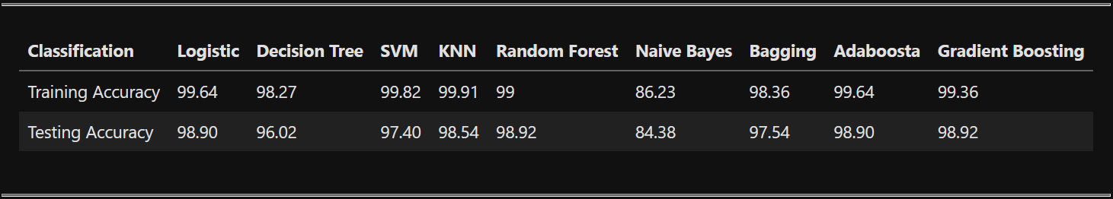
Report
These are the accuracies for the different classification algorithms.

Slide 23
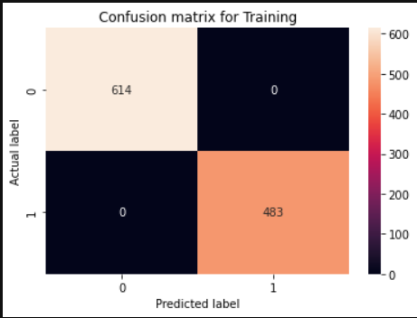
Confusion Matrix
For Gradient Boosting Classifier
The confusion matrix is a matrix used to determine the performance of the classification models for a given set of test data
Confusion Matrix for training dataset

Slide 24
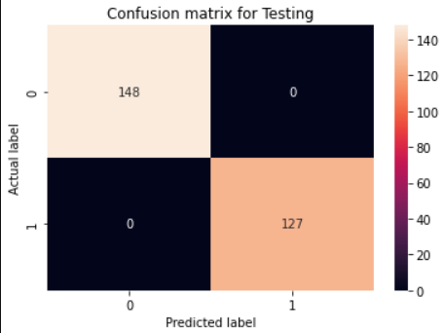
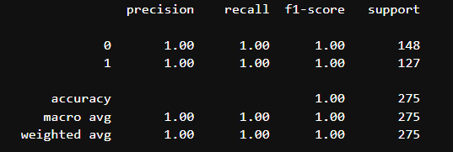
Result
For Gradient Boosting Classifier

Slide 25
Conclusion
Banknote authentication is an important task, It is difficult to manually detect fake bank notes.
As per the analysis Gradient Boosting Classifier Gives best accuracy as compared to other machine learning Algorithms.

Slide 26
Thank You!!

